Slide 1
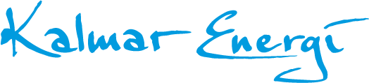
IoT meet-up 201126

Slide 2
Agenda 2020-12-26
Review of 2019
Meetings and workshops
Review of 2020 (do we really want to go there?)
Courses
Activities
Labs

Slide 3
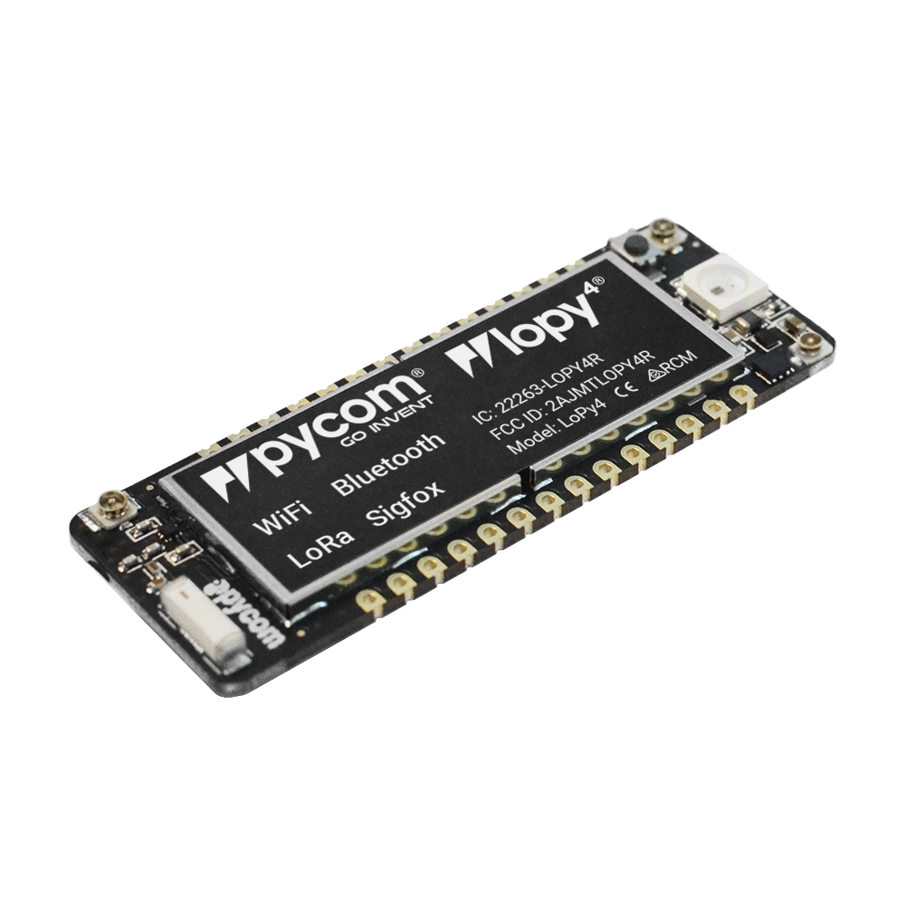

How all started?
Praktisk elteknik, Sjöingenjörer. Web of Things, Data/IT etc.
Idé - öppet nätverk. The Things Network.
Val av teknik – MicroPython.
Informell gruppering Fakulteten för Teknik.
Framförallt – intresse och glädje!

Slide 4
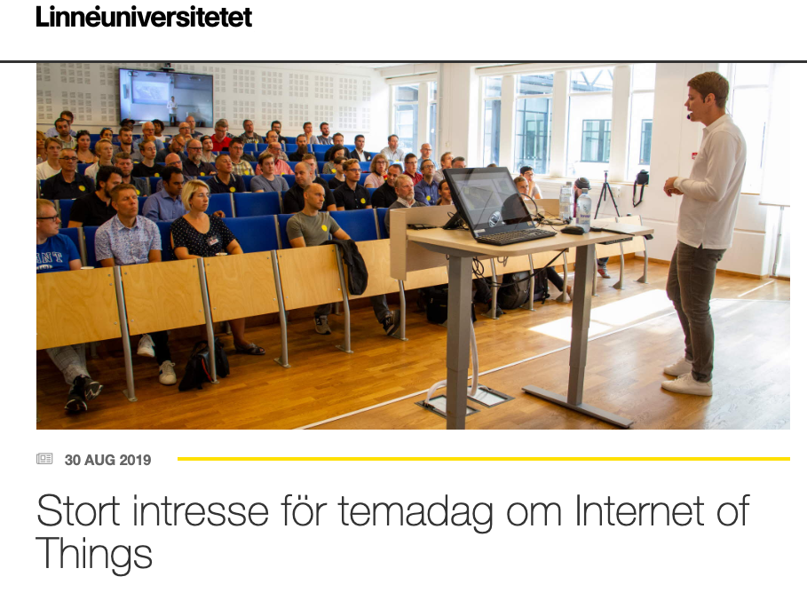
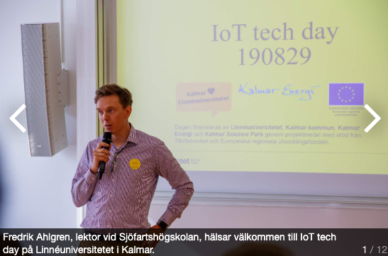
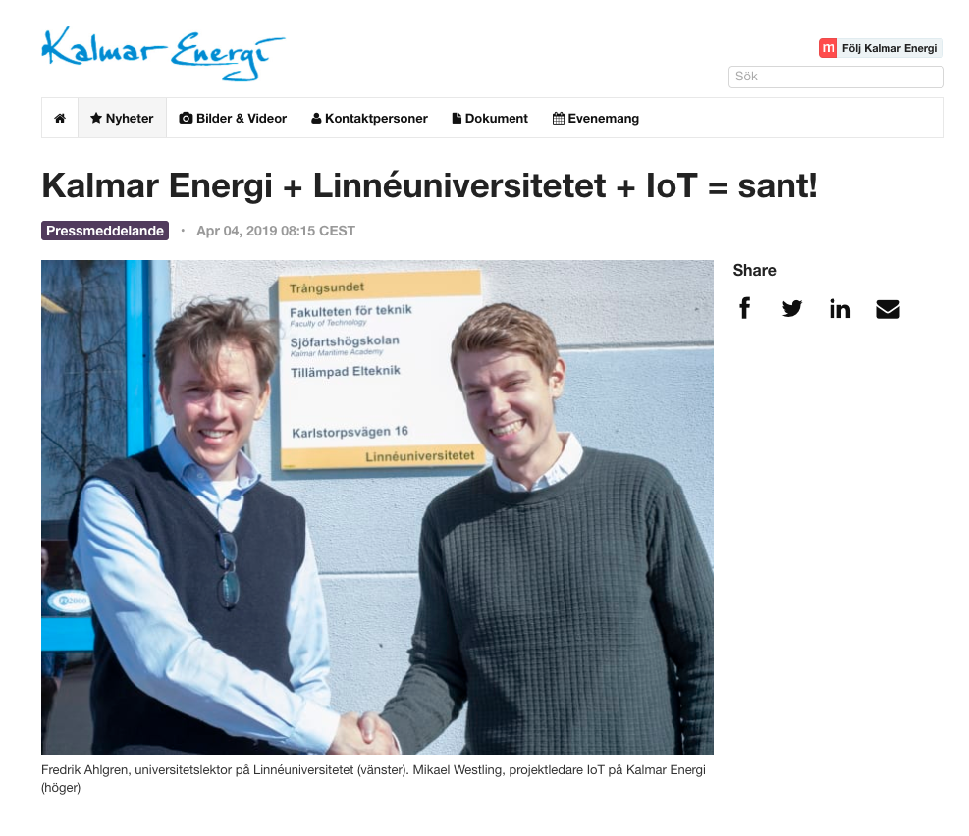
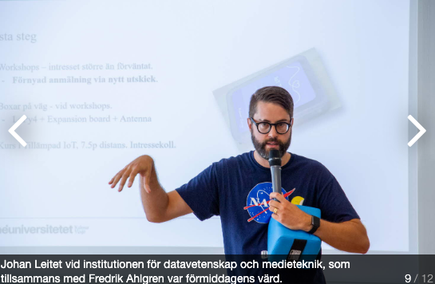

Slide 5
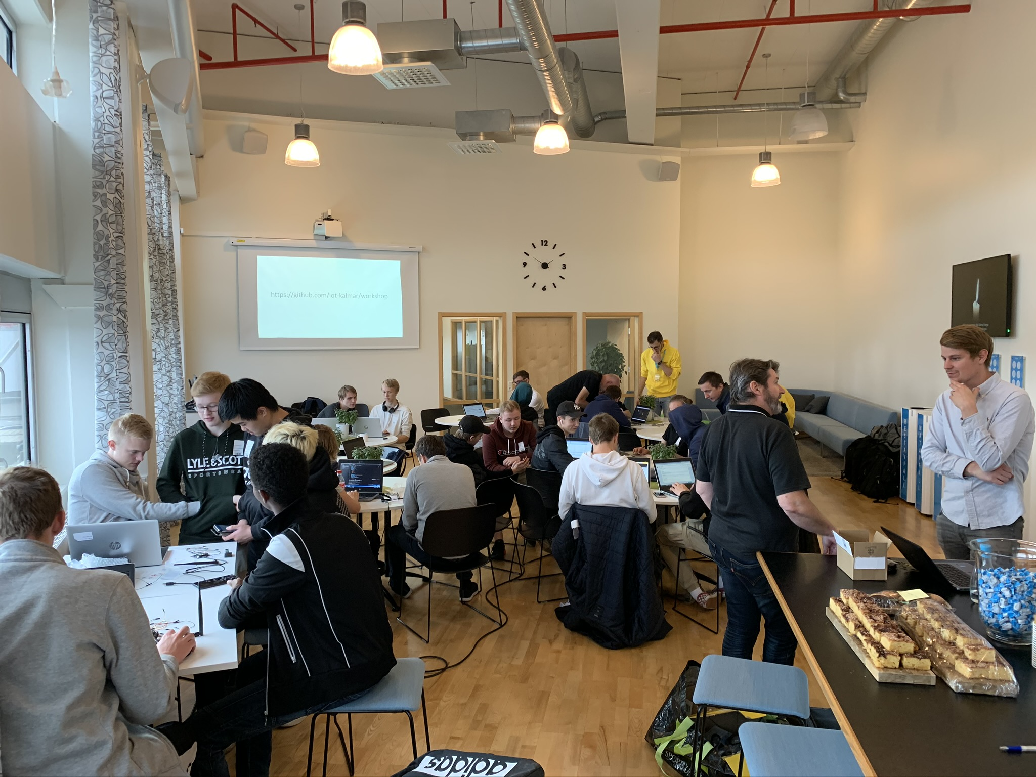
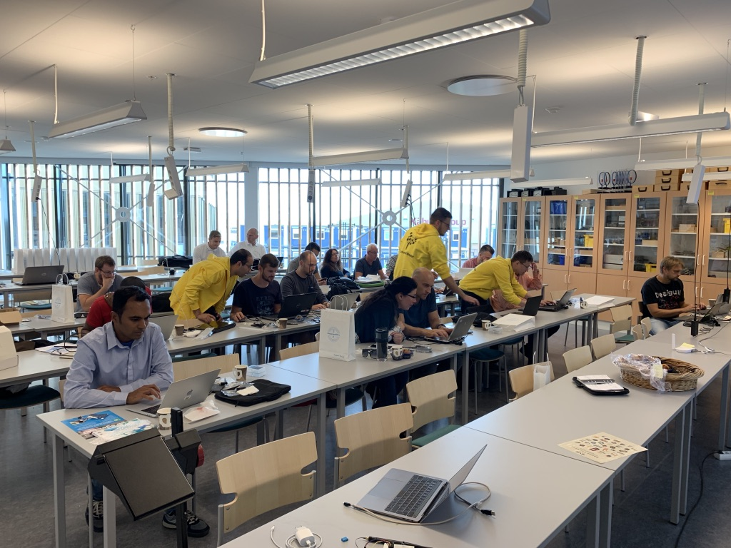
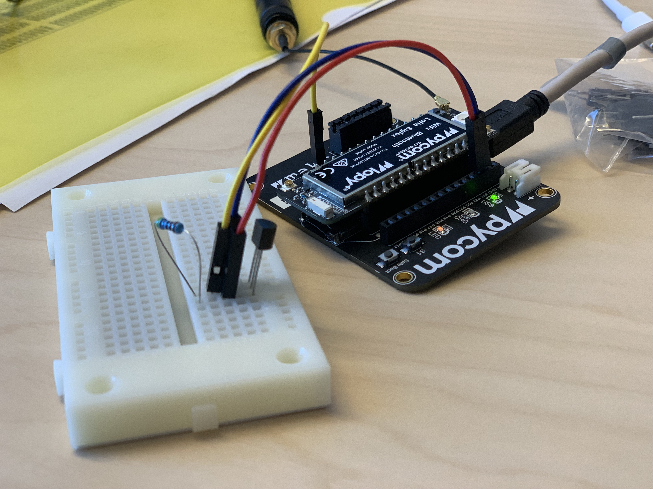
Workshops
MicroPython - IoT, LoRaWAN, MQTT, Grafana, Node-Red

Slide 6
What’s soon to happen? 2019
Campus summer 2020. LUSA, 7.5p. Introduction Applied IoT.
Students from all over the world. Could be 20-ish.
What we need: Project ideas for project work.
Francis Palma course instructor.
Distance course late spring 2020. Expert Competence, 3p. Applied IoT.
Aimed for industry.
Distance – with non obligatory workshops.
Course instructor – Not yet decided
Project IoT within farmer irrigation, Ragnabo. RISE / LNU.
Student projects with Kalmar Municipality, Serviceförvaltningen. 3 exjobb.

Slide 7
One more thing…

Slide 8
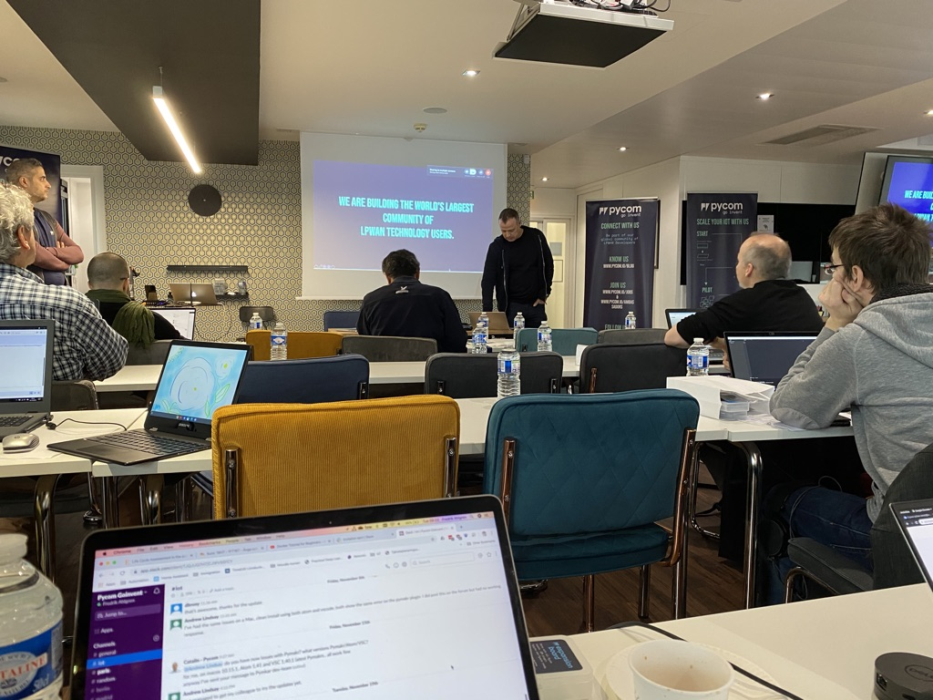
Two day Hackathon April / May - 20
General idea:
Day one - Pycom workshop, led by the Pycom Team
Late day one - Networking and dinner.
Until next day – full night Hackathon. Teams compete in creating the most innovative IoT project.
Day two – Keynote speaker. Prize ceremony for Hackathon contest.
What we need:
Funding and ideas! Food, venue, prize money and equipment. ~ 100k.
COVID-19 ICE BOX

Slide 9
IoT summer course Distance
More than 1000 applicants from all over Sweden
Most had no previous IoT/programming knowledge
100 % at distance – still applied
185 fantastic IoT projects
Best projects shown here:
https://hackmd.io/@lnu-iot/good-examples

Slide 10
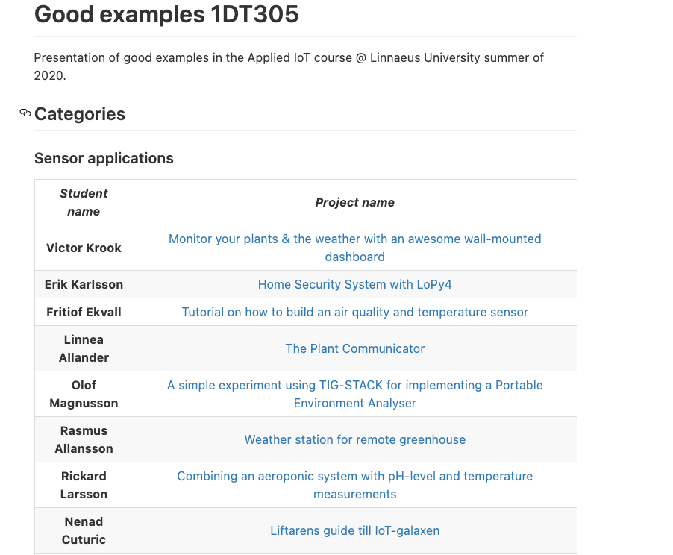
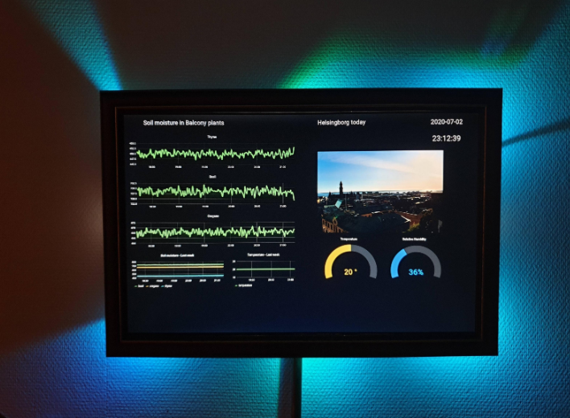
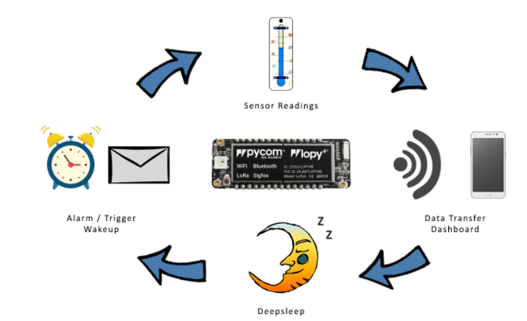

Slide 11
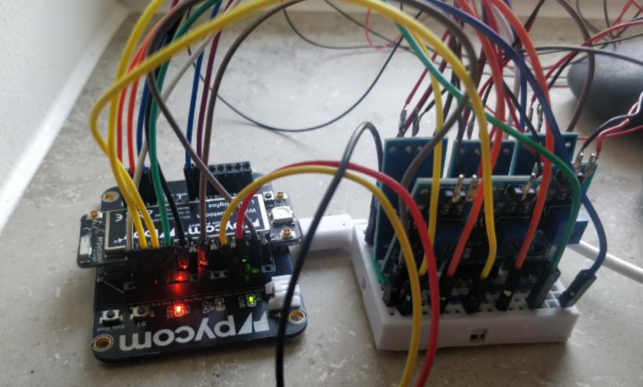
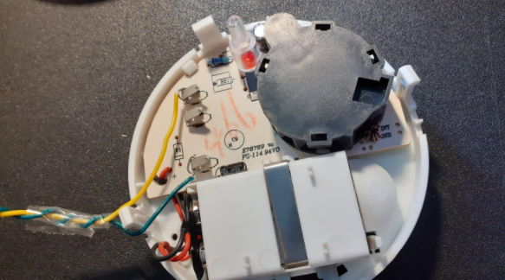
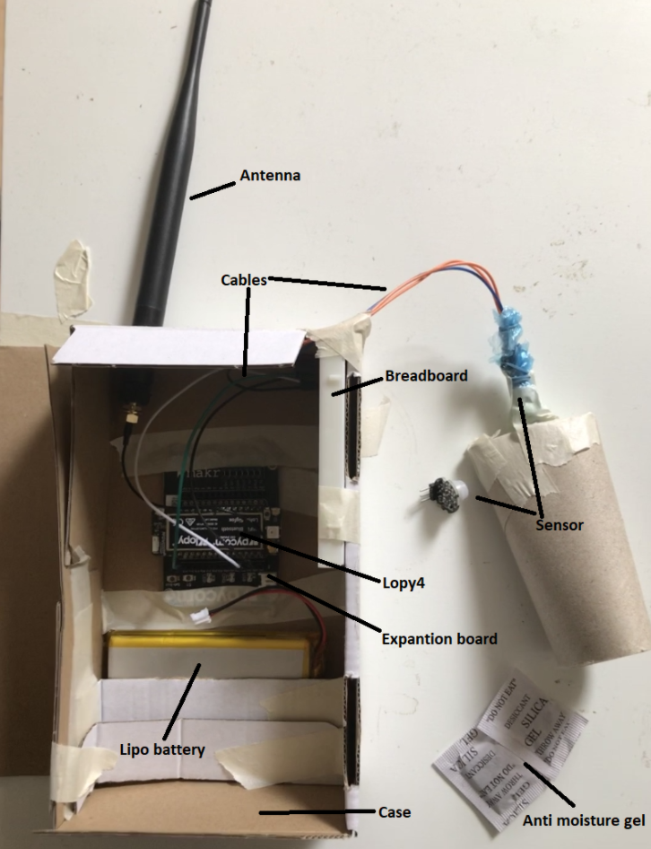
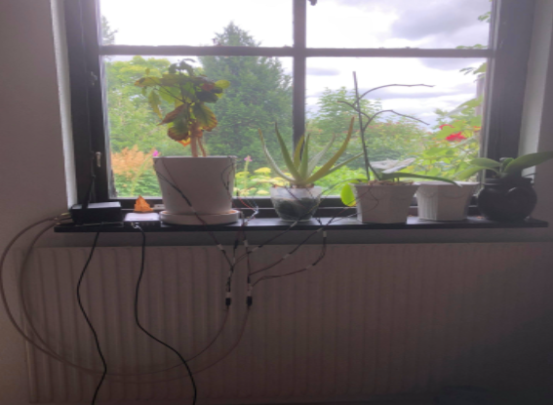

Slide 12
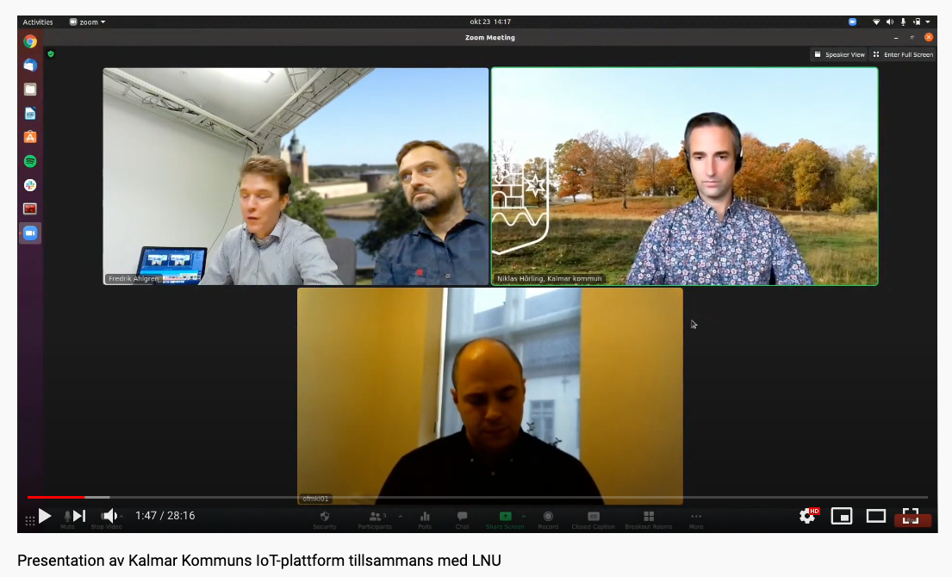
IoT projects now
Ongoing course – 1st year Engineering students
More than 30 IoT projects, Kalmar Kommun and Kalmar Energi
https://youtu.be/H2dSHswHegw

Slide 13
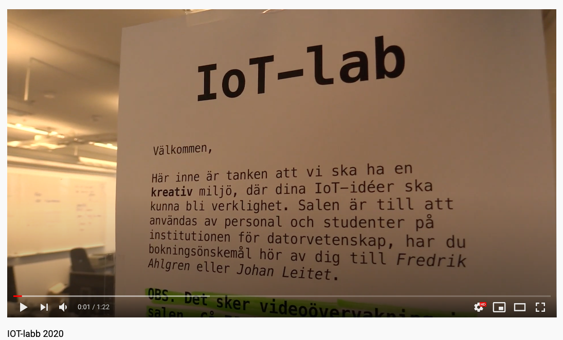
The IoT-lab
IoT lab @ Kalmar Campus
Open space, IoT education, innovation and research
We want collaborations
https://youtu.be/kG_3l2dDhFk

